Slide 1
Introduction to Anemia

Slide 2
Blood
All organs of the body communicate with each other via blood. It consists of water with many proteins dissolved in it (= plasma) as well as blood cells.
Blood enables the exchange of nutrients gas and hormones.
The functions of the blood are mediated by the proteins dissolved in the plasma (plasma proteins) as well as by special blood cells (red blood cells, platelets and white blood cells).
The composition of the blood:
a)Plasma volume: 55%
90% water
10% dissolved substances(proteine mostly)
b)Cell volume: 45%
99% red blood cells
Approximately 1% platelets and white blood cells.

Slide 3
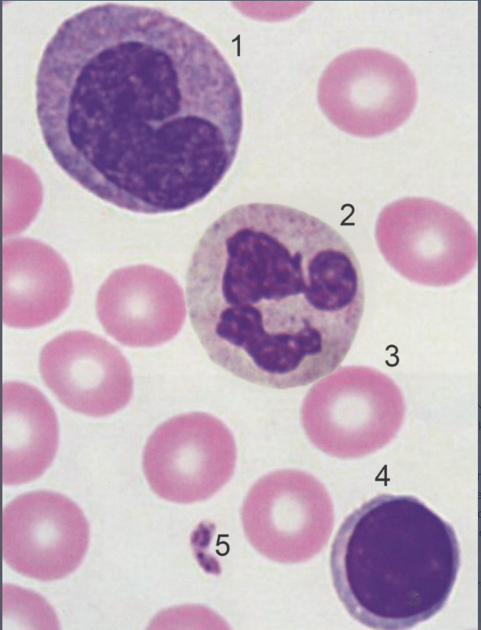
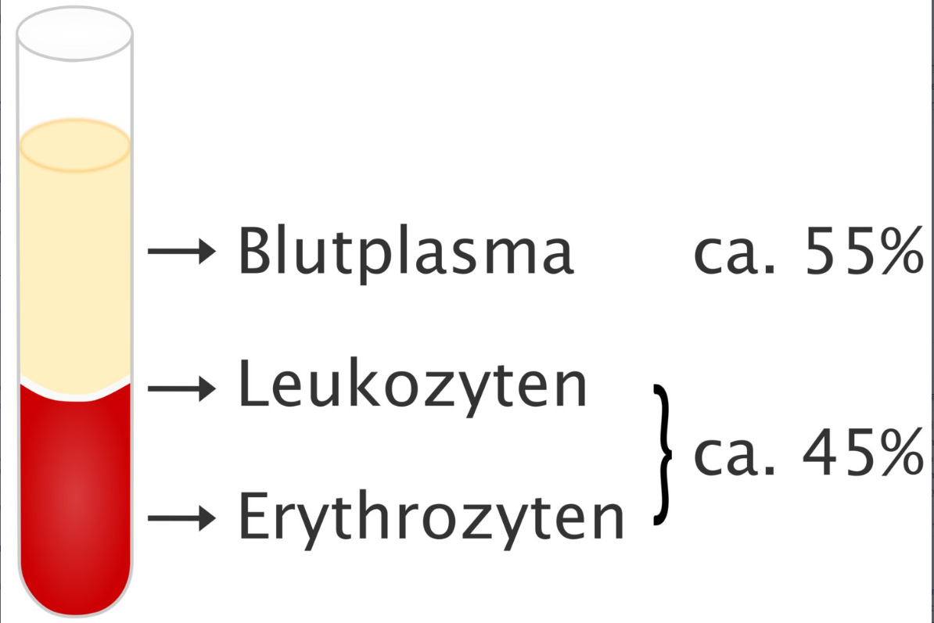
Blood

Slide 4
Red blood cells
red blood cells are the most common cells in the blood. One of their most important tasks is the transport of oxygen and carbon dioxide.
consist largely of the protein hemoglobin.(thiswhy red color)
Due to the hemoglobin, red blood cells are extremely rich in iron with around 0.5 g per liter of blood - so they contain over 50% of the body's total iron stores (approx. 5-7 g)!
red blood cell indices:
The red blood cells indices describe size (MCV), hemoglobin content (MCH), hemoglobin concentration (MCHC) and the deviation of the mean red blood cell size (RDW). They are routine parameters in the clinic and allow, for example, the classification of anemia.

Slide 5
Red blood cell indices
1. Hct: Proportion of solid components of the blood in the total blood volume ≈ 45%
2.MCV: Mean corpuscular volume ≈ 90 fL
>>>Average size of a red blood cell
90 fl >>> normocytic red blood cells. If this value deviates upwards or downwards by at least 10%, one speaks of macrocytic or microcytic red blood cells!
3.MCH: Mean corpuscular hemoglobin ≈ 30 pg
>>Average hemoglobin content of a red blood cell
30 pg corresponds to normochromic red blood cells. If this value deviates upwards or downwards by at least 10%, one speaks of hyperchromic or hypochromic red blood cells!
4.MCHC: Mean corpuscular hemoglobin concentration ≈ 330 g/L
Meaning: Average hemoglobin concentration in red blood cells
Classification of Anemias:
Anemia (anemia) occurs when there are too few red blood cells(erythrocyte count↓) or too little hemoglobin (hemoglobin concentration↓) in the blood.
1.Microcytic hypochromic (MCV↓, MCH↓) :for example iron deficiency
2.Normocytic normochromic (MCV→, MCH→) :bleeding anemia
3. Macrocytic hyperchromic (MCV↑, MCH↑): vit b12 deficiency, folic acid deficiency, alcoholism

Slide 6
